Slide 1



D-43
Open IIT - Data Analytics

Slide 2







AGENDA
Data Extraction
Exploratory
Data Analysis
Data pre-processing
& Feature Engineering
Forecasting Models
Rescheduling
Results

Slide 3

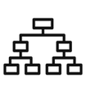




DATA EXTRACTION
DATA EXTRACTION
EDA
PRE-
PROCESSING
FORECASTING
MODEL
RESCHEDULE
MODEL
We used the dataset from the US Department of Transportation, Bureau of Transportation Statistics which included flight routes (origin, destination), time ranges for events (minutes, local time), delay and cancellation features from January 2019 – August 2023.
We also included season and holiday features to increase the performance of our models.
Key Variables
Flight Details: Fields such as origin and destination airports, and scheduled vs. actual departure/arrival times
Delay Information
Categorical Features: airline codes and airport codes
Additional Attributes: Unique identifiers, such as flight numbers and timestamps

Slide 4

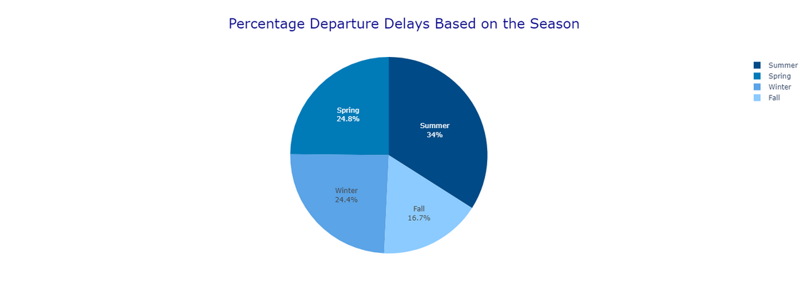
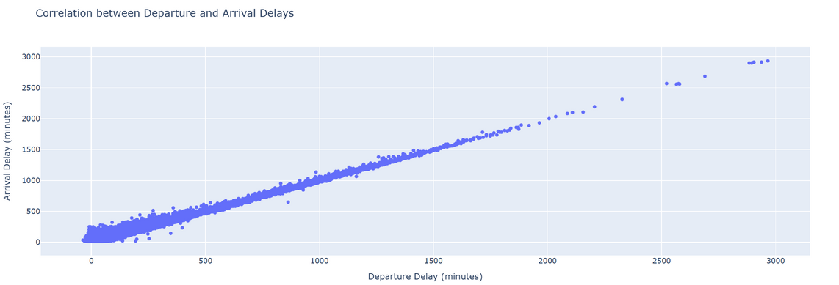
EXPLORATORY
DATA ANALYSIS
On applying EDA to various dataset, we have observed that there is a seasonal variation in the data for the Flight Delays. For example in Summer, The flight delays are more than winter and fall.

Slide 5

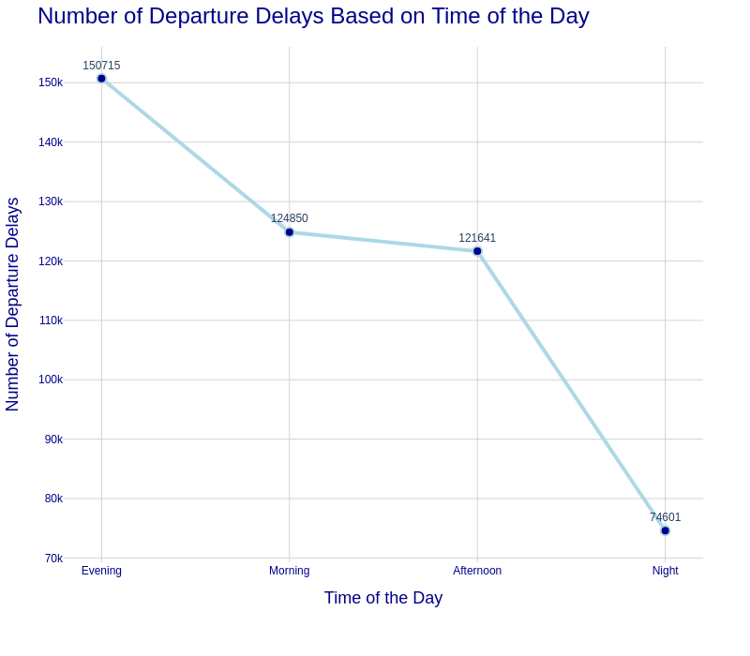
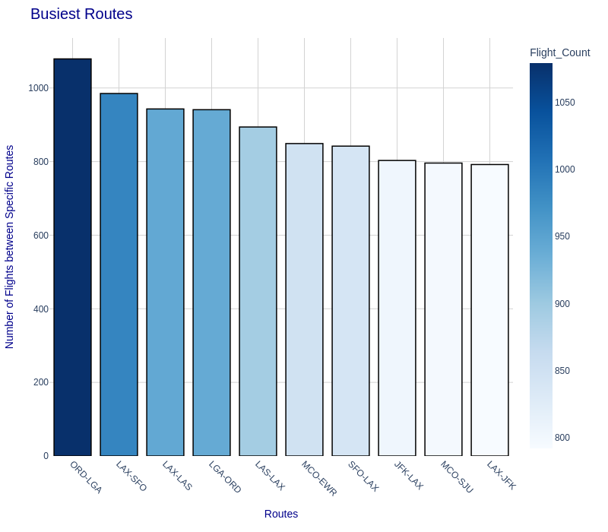
EXPLORATORY DATA ANALYSIS
DATA EXTRACTION
DATA EXTRACTION
PRE-
PROCESSING
PRE-
PROCESSING
RESCHEDULE
MODEL
EDA
EDA
FORECASTING
MODEL
FORECASTING
MODEL
Certain routes are the busiest. ORD-LGA being one of the busiest routes has the highest number of departure delays, which is quite obvious.

Slide 6
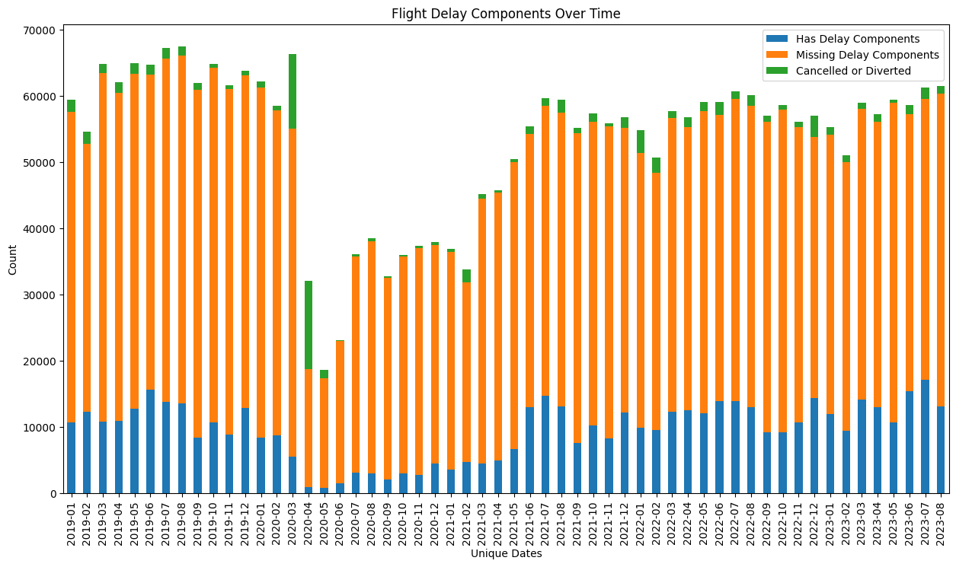
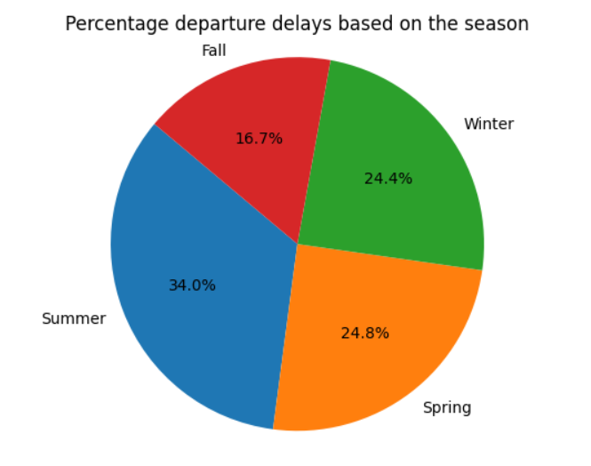
EXPLORATORY DATA ANALYSIS
DATA EXTRACTION
DATA EXTRACTION
PRE-
PROCESSING
PRE-
PROCESSING
RESCHEDULE
MODEL
EDA
EDA
FORECASTING
MODEL
FORECASTING
MODEL
Flight delays can be broken down into various components that vary over time, typically categorized into departure delays, in-flight delays, and arrival delays. Each component has distinct factors that contribute to the delay

Slide 7
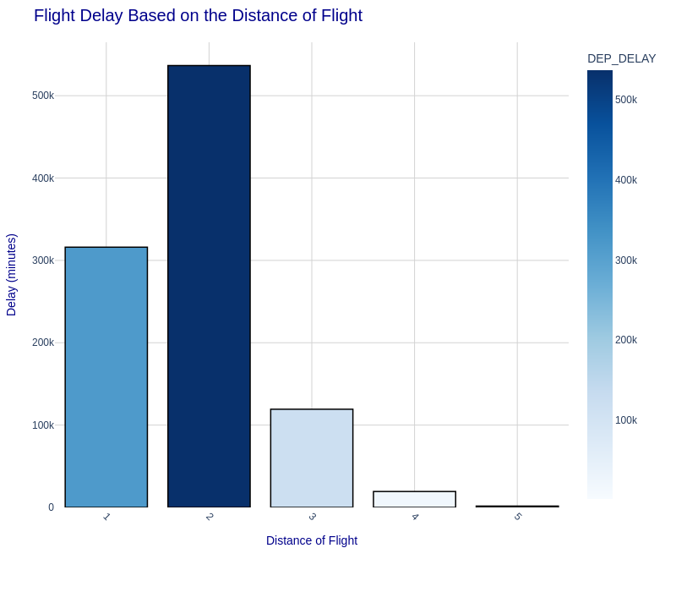
EXPLORATORY DATA ANALYSIS
DATA EXTRACTION
DATA EXTRACTION
PRE-
PROCESSING
PRE-
PROCESSING
RESCHEDULE
MODEL
EDA
EDA
FORECASTING
MODEL
FORECASTING
MODEL
Long-distance flights tend to experience shorter average delays compared to shorter flights, indicating a possible prioritization of longer routes at airports. This trend suggests that airports may prioritize clearing shorter-distance flights more quickly, potentially to manage gate availability and streamline traffic flow for high-frequency short-haul routes. By allowing shorter flights to depart with minimal delay, airports can better accommodate the complex logistics involved with longer flights, which often require more resources and planning for extended durations. This strategy helps balance airport operations and maintain efficiency across both types of routes.

Slide 8
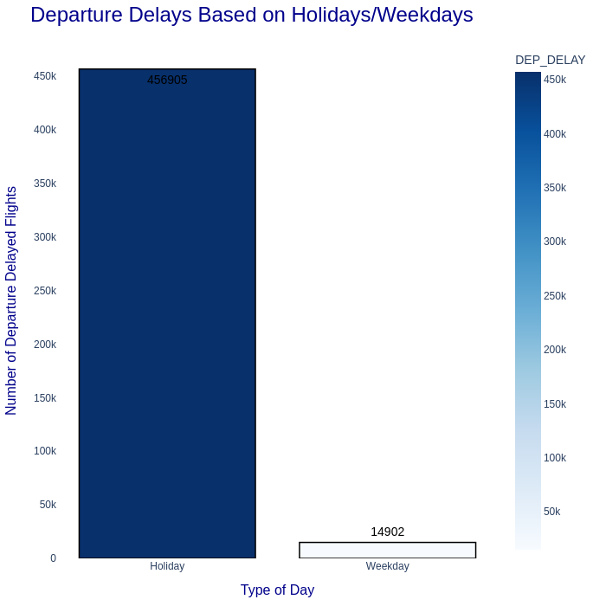
EXPLORATORY DATA ANALYSIS
DATA EXTRACTION
DATA EXTRACTION
PRE-
PROCESSING
PRE-
PROCESSING
RESCHEDULE
MODEL
EDA
EDA
FORECASTING
MODEL
FORECASTING
MODEL
On holidays, the number of flight delays is nearly 30 times higher than on typical weekdays. This spike in delays is largely due to the increased passenger volume and operational load that airports experience during these peak times. As a result, airports face additional challenges in managing schedules and resources, leading to a noticeable rise in average delay times compared to weekdays, when operations are generally smoother with fewer disruptions.

Slide 9
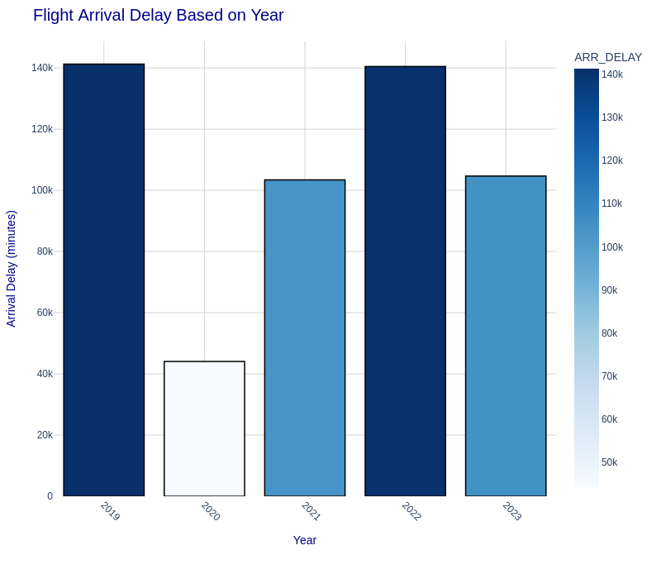
EXPLORATORY DATA ANALYSIS
DATA EXTRACTION
DATA EXTRACTION
PRE-
PROCESSING
PRE-
PROCESSING
RESCHEDULE
MODEL
EDA
EDA
FORECASTING
MODEL
FORECASTING
MODEL
Also, year 2020 and 2021, had the least number of flights with flight operations being dormant for most parts of the year, hence the least load on airports and thus, less average delay.

Slide 10
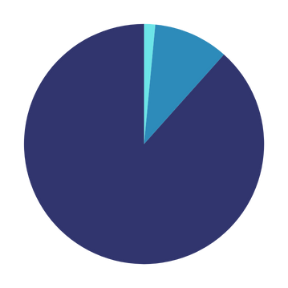
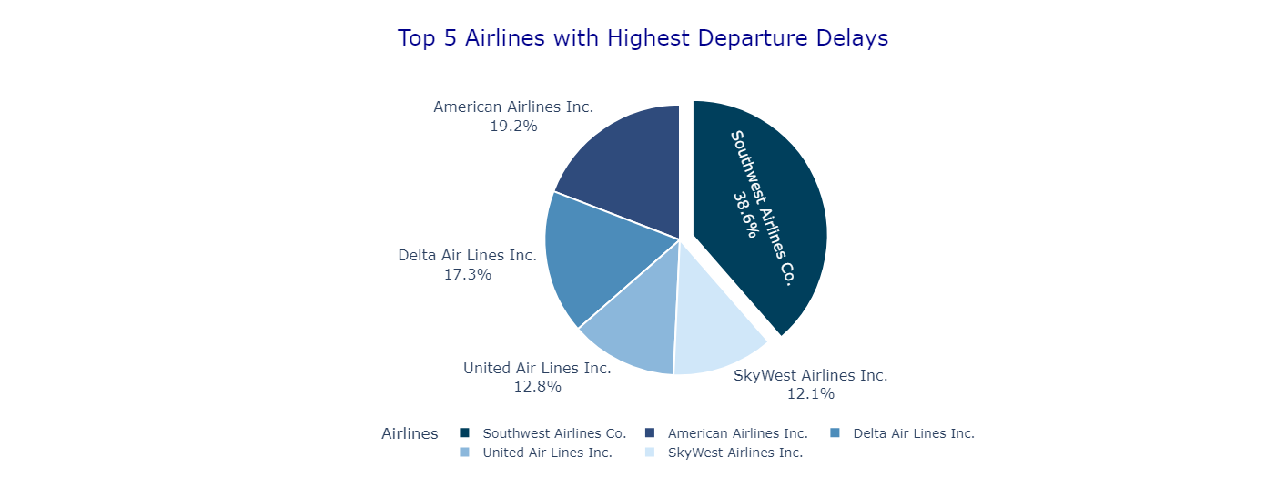
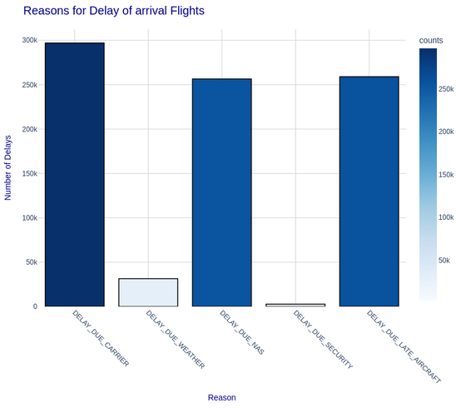
DATA PRE-PROCESSING
DATA EXTRACTION
PRE-
PROCESSING
PRE-
PROCESSING
RESCHEDULE
MODEL
EDA
FORECASTING
MODEL
FORECASTING
MODEL
Most of the flights are delayed as is shown by the graph - Over 85 percent of the flights already depart late which suggest need for optimization in their scheduling, and also the arrival delays show a very high correlation with departure delay, with their correlation being over 97 percent.
Certain airline companies, more notably Southwest Airlines have an
unusally high departure delay on an average, comprising of nearly 40
percent of the departure delays.
Most of the delay is caused due to Carrier, followed by late aircrafts.
Security reasons are the least cause of flight delays.
DELAYED
88.4%

Slide 11
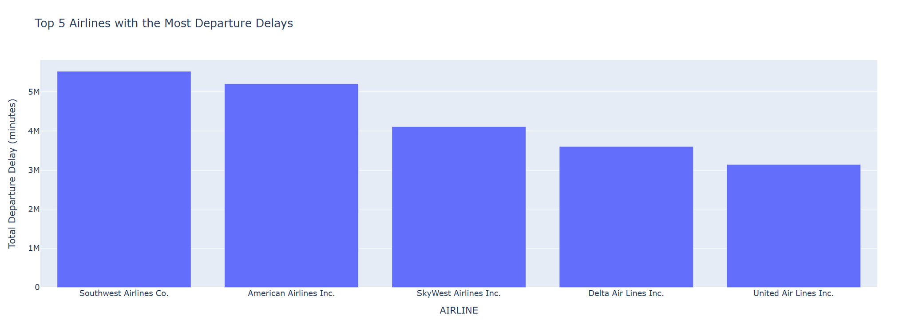
DATA PRE-PROCESSING
DATA EXTRACTION
PRE-
PROCESSING
PRE-
PROCESSING
RESCHEDULE
MODEL
EDA
EDA
FORECASTING
MODEL
FORECASTING
MODEL
Certain airline companies, more notably South-west Airlines have an unusally high departure delay on an average, comprising of nearly 40 percent of the departure delays.

Slide 12
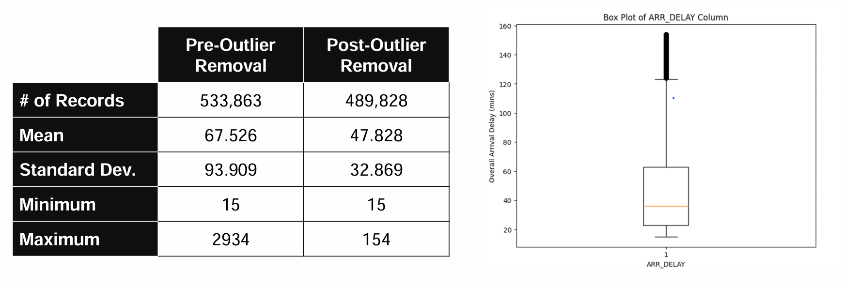
Feature Selection
DATA EXTRACTION
EDA
PRE-
PROCESSING
FORECASTING
MODEL
RESCHEDULE
MODEL
Pearson’s Correlation between 6 non-categorical independent attributes: CRS_DEP_TIME, TAXI_OUT, CRS_ARR_TIME, TAXI_IN, CRS_ELASPED_TIME DISTANCE and dependent variable: ARR_DELAY.
PCA on normalized data did not help increase correlation.
Eliminated redundancies in categorical attributes which was verified using The Kruskal Wallis H-test.
OUTLIER PRUNING

Slide 13
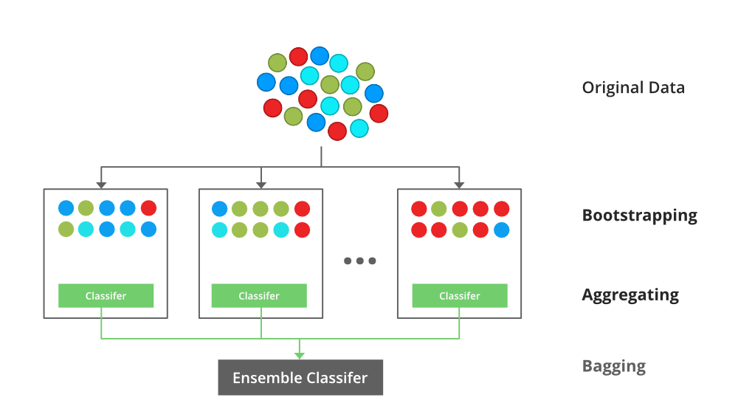
DATA EXTRACTION
PRE-
PROCESSING
FORECASTING
MODEL
RESCHEDULE
MODEL
Forecasting Model
EDA
XGBoost (Extreme Gradient Boosting) is a powerful machine learning algorithm that builds an ensemble of decision trees to make accurate predictions, particularly for structured data. It uses gradient boosting to iteratively improve model performance by minimizing errors, combining the strengths of each tree. Known for its efficiency and scalability, XGBoost is widely used for its high accuracy in classification and regression tasks.

Slide 14
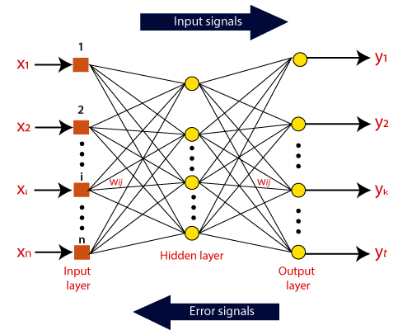
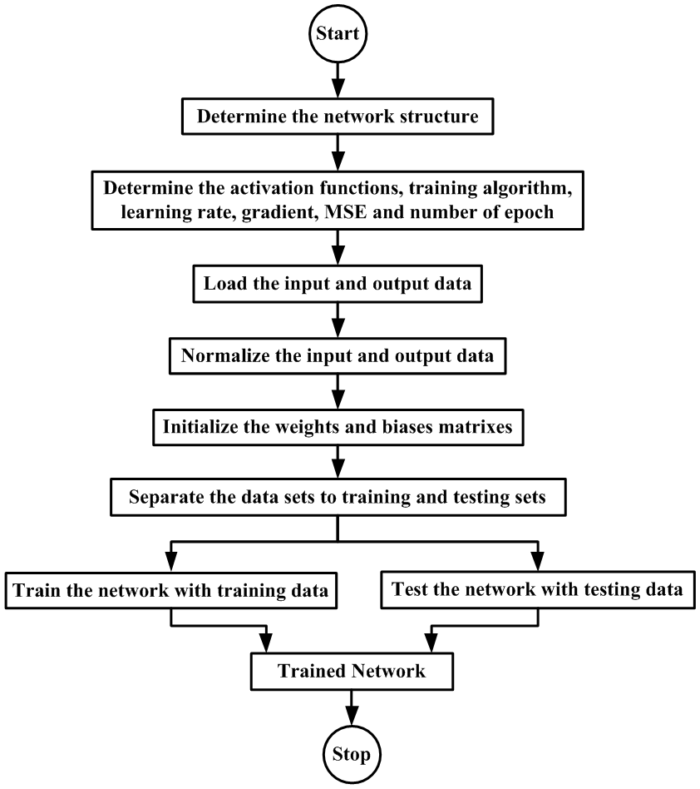
DATA EXTRACTION
PRE-
PROCESSING
FORECASTING
MODEL
RESCHEDULE
MODEL
Forecasting Model
EDA
An Artificial Neural Network (ANN) is a model inspired by the brain's structure, using layers of interconnected "neurons" to recognize patterns in data. Each neuron processes inputs, applies weights and activation functions, then passes the result to the next layer. ANNs are widely used in tasks like image recognition and predictive modeling due to their ability to learn complex relationships.

Slide 15
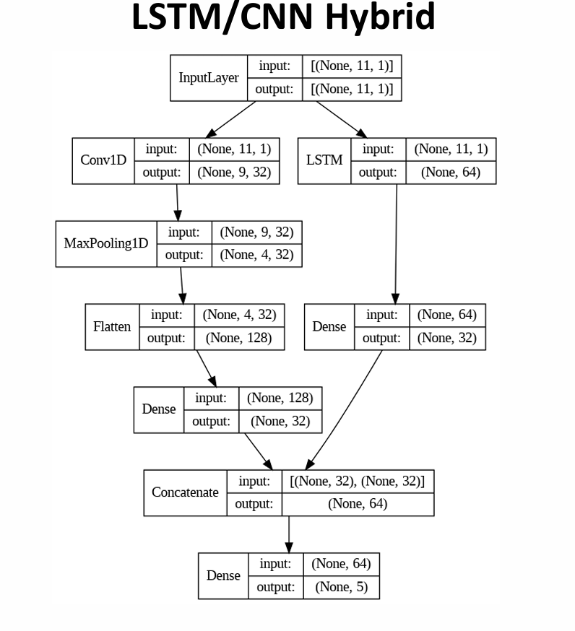
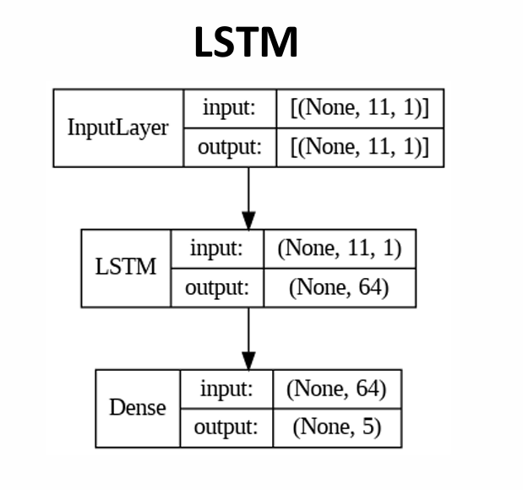
DATA EXTRACTION
PRE-
PROCESSING
FORECASTING
MODEL
RESCHEDULE
MODEL
Forecasting Model
EDA
The LSTM models outperformed baseline models, achieving accurate delay predictions. The rescheduling approach effectively reduced cumulative delays, indicating its value in operational optimization.

Slide 16
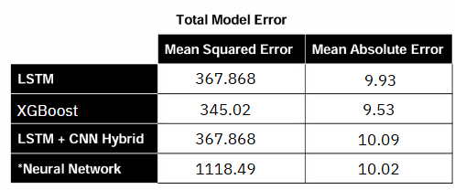
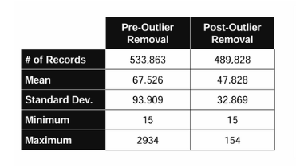
DATA EXTRACTION
PRE-
PROCESSING
FORECASTING
MODEL
RESCHEDULE
MODEL
Forecasting Model
EDA
Results:
The model achieved an impressive Mean Absolute Error (MAE) of 9.43, highlighting its exceptional accuracy and reliability in making predictions. This low error rate reflects the model's robustness in capturing complex patterns and minimizing prediction deviations.

Slide 17
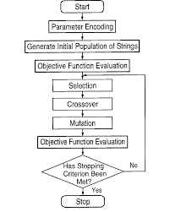
Reschedule Modelling
DATA EXTRACTION
EDA
PRE-
PROCESSING
FORECASTING
MODEL
RESCHEDULE
MODEL
A Genetic Algorithm (GA) is a search heuristic that mimics the process of natural selection. This heuristic is routinely used to generate useful solutions to optimization and search problems. The algorithm reflects the process of natural evolution, where the fittest individuals are selected for reproduction in order to produce offspring of the next generation.
Population: A set of potential solutions to the problem.
Chromosomes: A representation of a solution. Typically, this is a string of bits, but other representations are possible.
Genes: Parts of a chromosome, representing a specific trait of the solution.
Fitness Function: A function that evaluates how close a given solution is to the optimum solution of the problem.
Selection: The process of choosing the fittest individuals from the population to create offspring.
Crossover (Recombination): A genetic operator used to combine the genetic information of two parents to generate new offspring.
Mutation: A genetic operator used to maintain genetic diversity within the population by randomly tweaking the genes of individuals.

Slide 18
Reschedule Modelling
DATA EXTRACTION
EDA
PRE-
PROCESSING
FORECASTING
MODEL
RESCHEDULE
MODEL
DATA SORTED THROUGH Genetic Algorithm (GA)
 | FL_DATE | AIRLINE | FL_NUMBER | ORIGIN | DEST | CRS_DEP_TIME | Optimized_CRS_DEP_TIME
1 | 2023-08-31 | Frontier Airlines Inc. | 2479 | IAH | PHX | 1517 | 1639
2 | 2023-08-31 | Republic Airline | 5834 | LGA | MSN | 1993 | 1951
3 | 2023-08-31 | Southwest Airlines Co. | 3188 | DEN | AUS | 1078 | 1130
4 | 2023-08-31 | Delta Air Lines Inc. | 1850 | CLT | ATL | 0922 | 0926
5 | 2023-08-31 | Delta Air Lines Inc. | 531 | LAX | DTW | 2359 | 2311

Slide 19
Future Scope and Conclusion:
While our model provides significant insights and optimizations, several areas could enhance its effectiveness further:
1.Integration of Real-Time Data: Incorporating real-time data, such as live weather updates and airport traffic, could improve the accuracy of delay predictions by accounting for sudden changes in operational conditions. This work has already begun from our side, that is we are trying to incorporate weather condition features like temperatures during time of departure of flight, and min. and max. temperatures in the departure city on that particular date. Factors like wind speed, wind direction, precipitation amount have also been added, which further adds to the realism in data. Once real time data is integrated, the accuracy of delay predictions could improve.
2.Advanced Ensemble Techniques: Exploring ensemble models that combine multiple machine learning approaches may yield more robust results, especially for complex scenarios with multiple interacting delay factors.
3.Broader Geographical and Operational Coverage: Expanding the model to include international flights and diverse airline operations would enhance its generalizability, making it applicable to global airline networks.
4.Optimization for Fuel and Cost Efficiency: Incorporating metrics related to fuel consumption and operational costs in the rescheduling model could lead to more comprehensive optimizations, benefiting both airlines and environmental sustainability.
5.Automated Decision Support System: Integrating the predictive and rescheduling models into an automated decision support system could enable real-time recommendations for flight management teams.

Slide 20
Annexure:
DATASETS AND OTHER INFORMATION
https://www.kaggle.com/datasets/patrickzel/flight-delay-and-cancellation-dataset-2019-2023
https://www.kaggle.com/datasets/bordanova/2023-us-civil-flights-delay-meteo-and-aircraft/data
https://www.kaggle.com/datasets/giovamata/airlinedelaycauses
https://trafficindex.org/chennai/
RESEARCH PAPERS REFERRED -
https://www.sciencedirect.com/science/article/pii/S0957417424001714
https://scientiairanica.sharif.edu/article_20020.html
https://journalofbigdata.springeropen.com/articles/10.1186/s40537-020-00380-z
https://www.irjmets.com/uploadedfiles/paper/issue_5_may_2022/22985/final/fin_irjmets1652551445.pdf
https://www.researchgate.net/publication/341872407_Flight_Delay_Prediction_System
https://dl.acm.org/doi/fullHtml/10.1145/3497701.3497725
https://paperswithcode.com/dataset/flight-delay-and-cancellation-dataset-2019
https://factly.in/data-quantum-of-passengers-affected-by-airline-delays-cancellations-back-to-pre-covid-levels/
https://cs229.stanford.edu/proj2017/final-reports/5243248.pdf
https://www.semanticscholar.org/paper/Flight-Arrival-Delay-Prediction-And-Analysis-Using-Dou/2ffd1af32245633d27de1a8b76bc774eaf04b7de

Slide 21


THANK YOU!

